Slide 1






Structured Disentangled Representations
Jan-Willem van de Meent
Babak Esmaeli
Hao Wu
Sarthak Jain
Alican Bozkurt
Siddharth N.
Oxford
Brooks Paige
Alan Turing Institute
Northeastern University

Slide 2
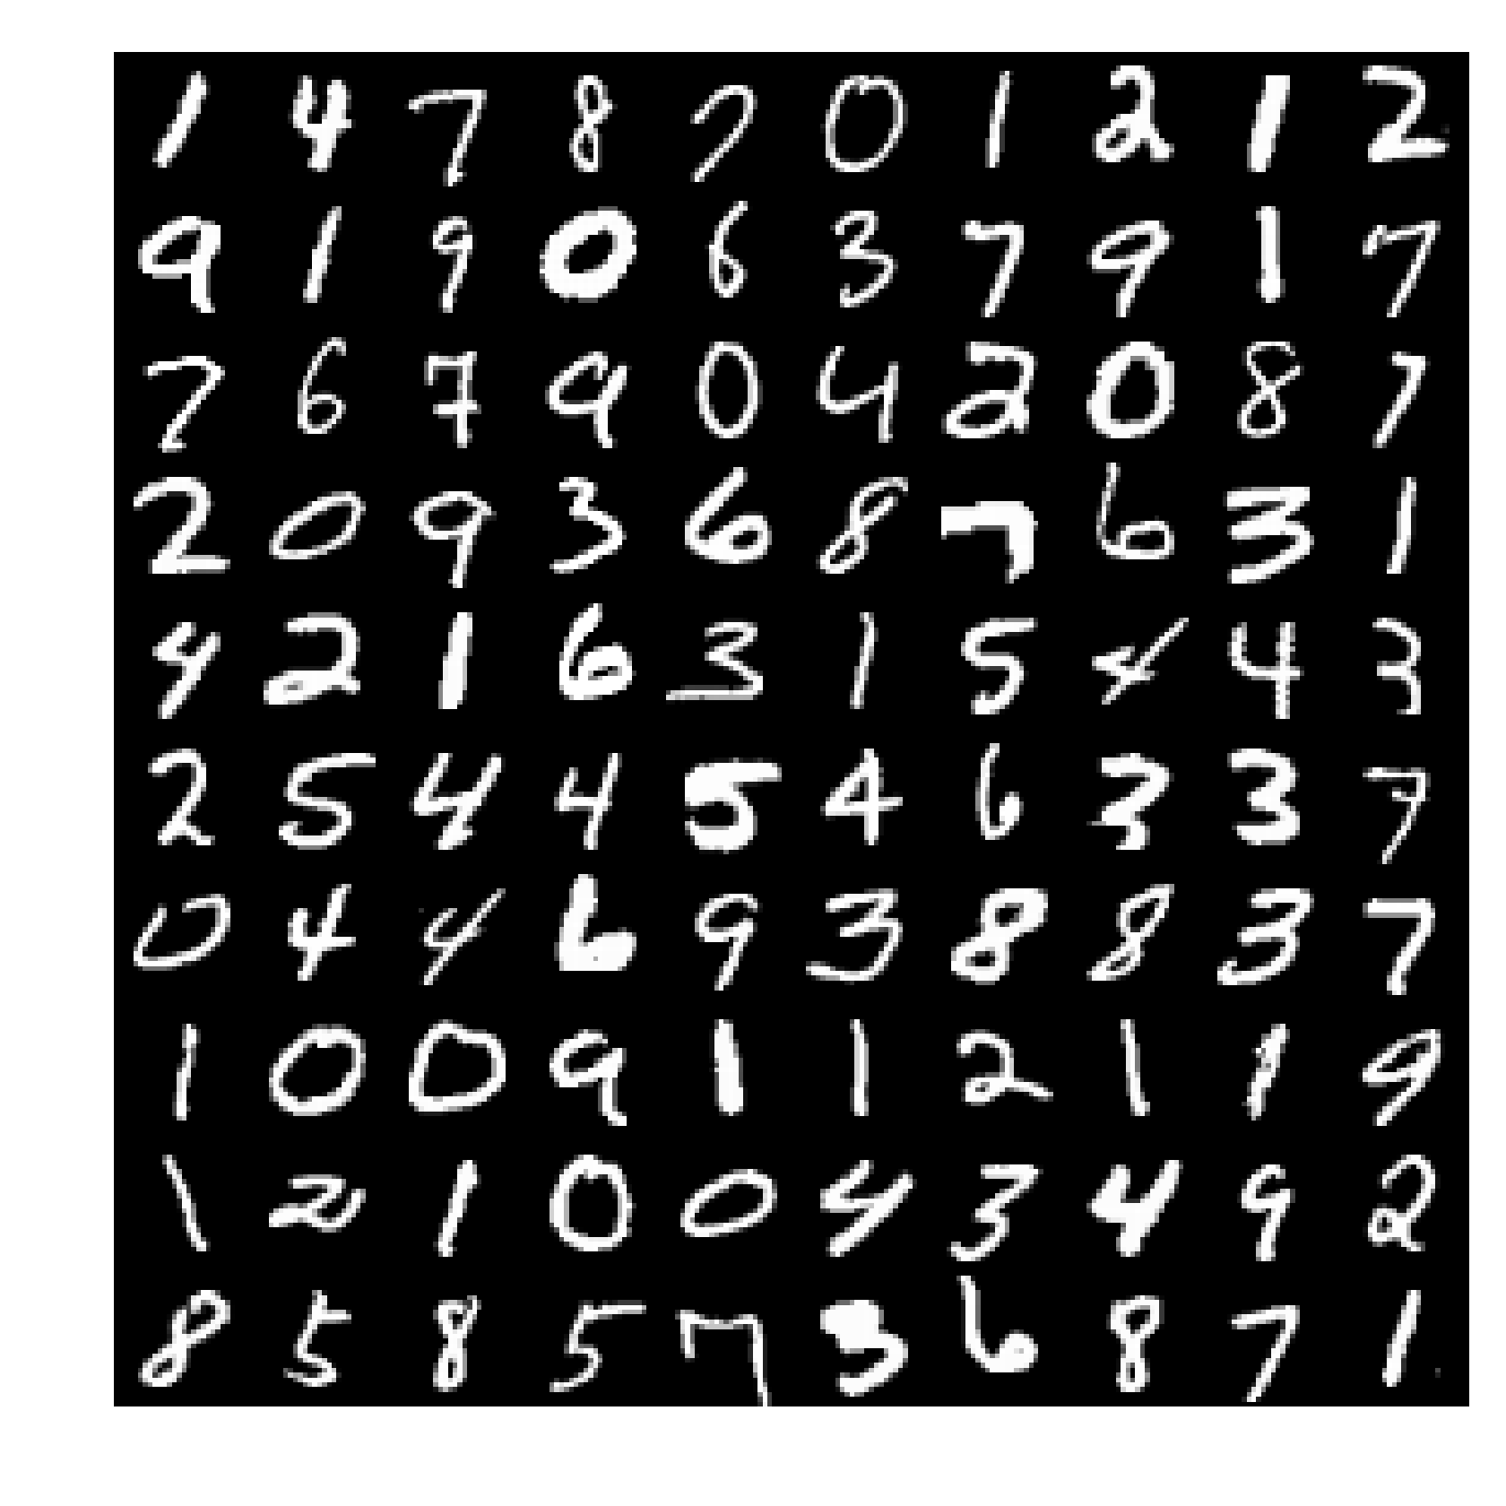
Learning Representations
Everyone’s Favorite Example: MNIST
Goal: Learn features that capture similarities and dissimilarities
Requirement: Objective that defines notion of utility (task-dependent)

Slide 3
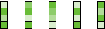
Autoencoders
Input
Images
Hidden
Units
Code
Hidden
Units
Reconstructed
Images
28 x 28
256
2-50
256
28 x 28
Notion of Utility: Ability to reconstruction of pixels from code
(features are a compressed representation of original data)

Slide 4
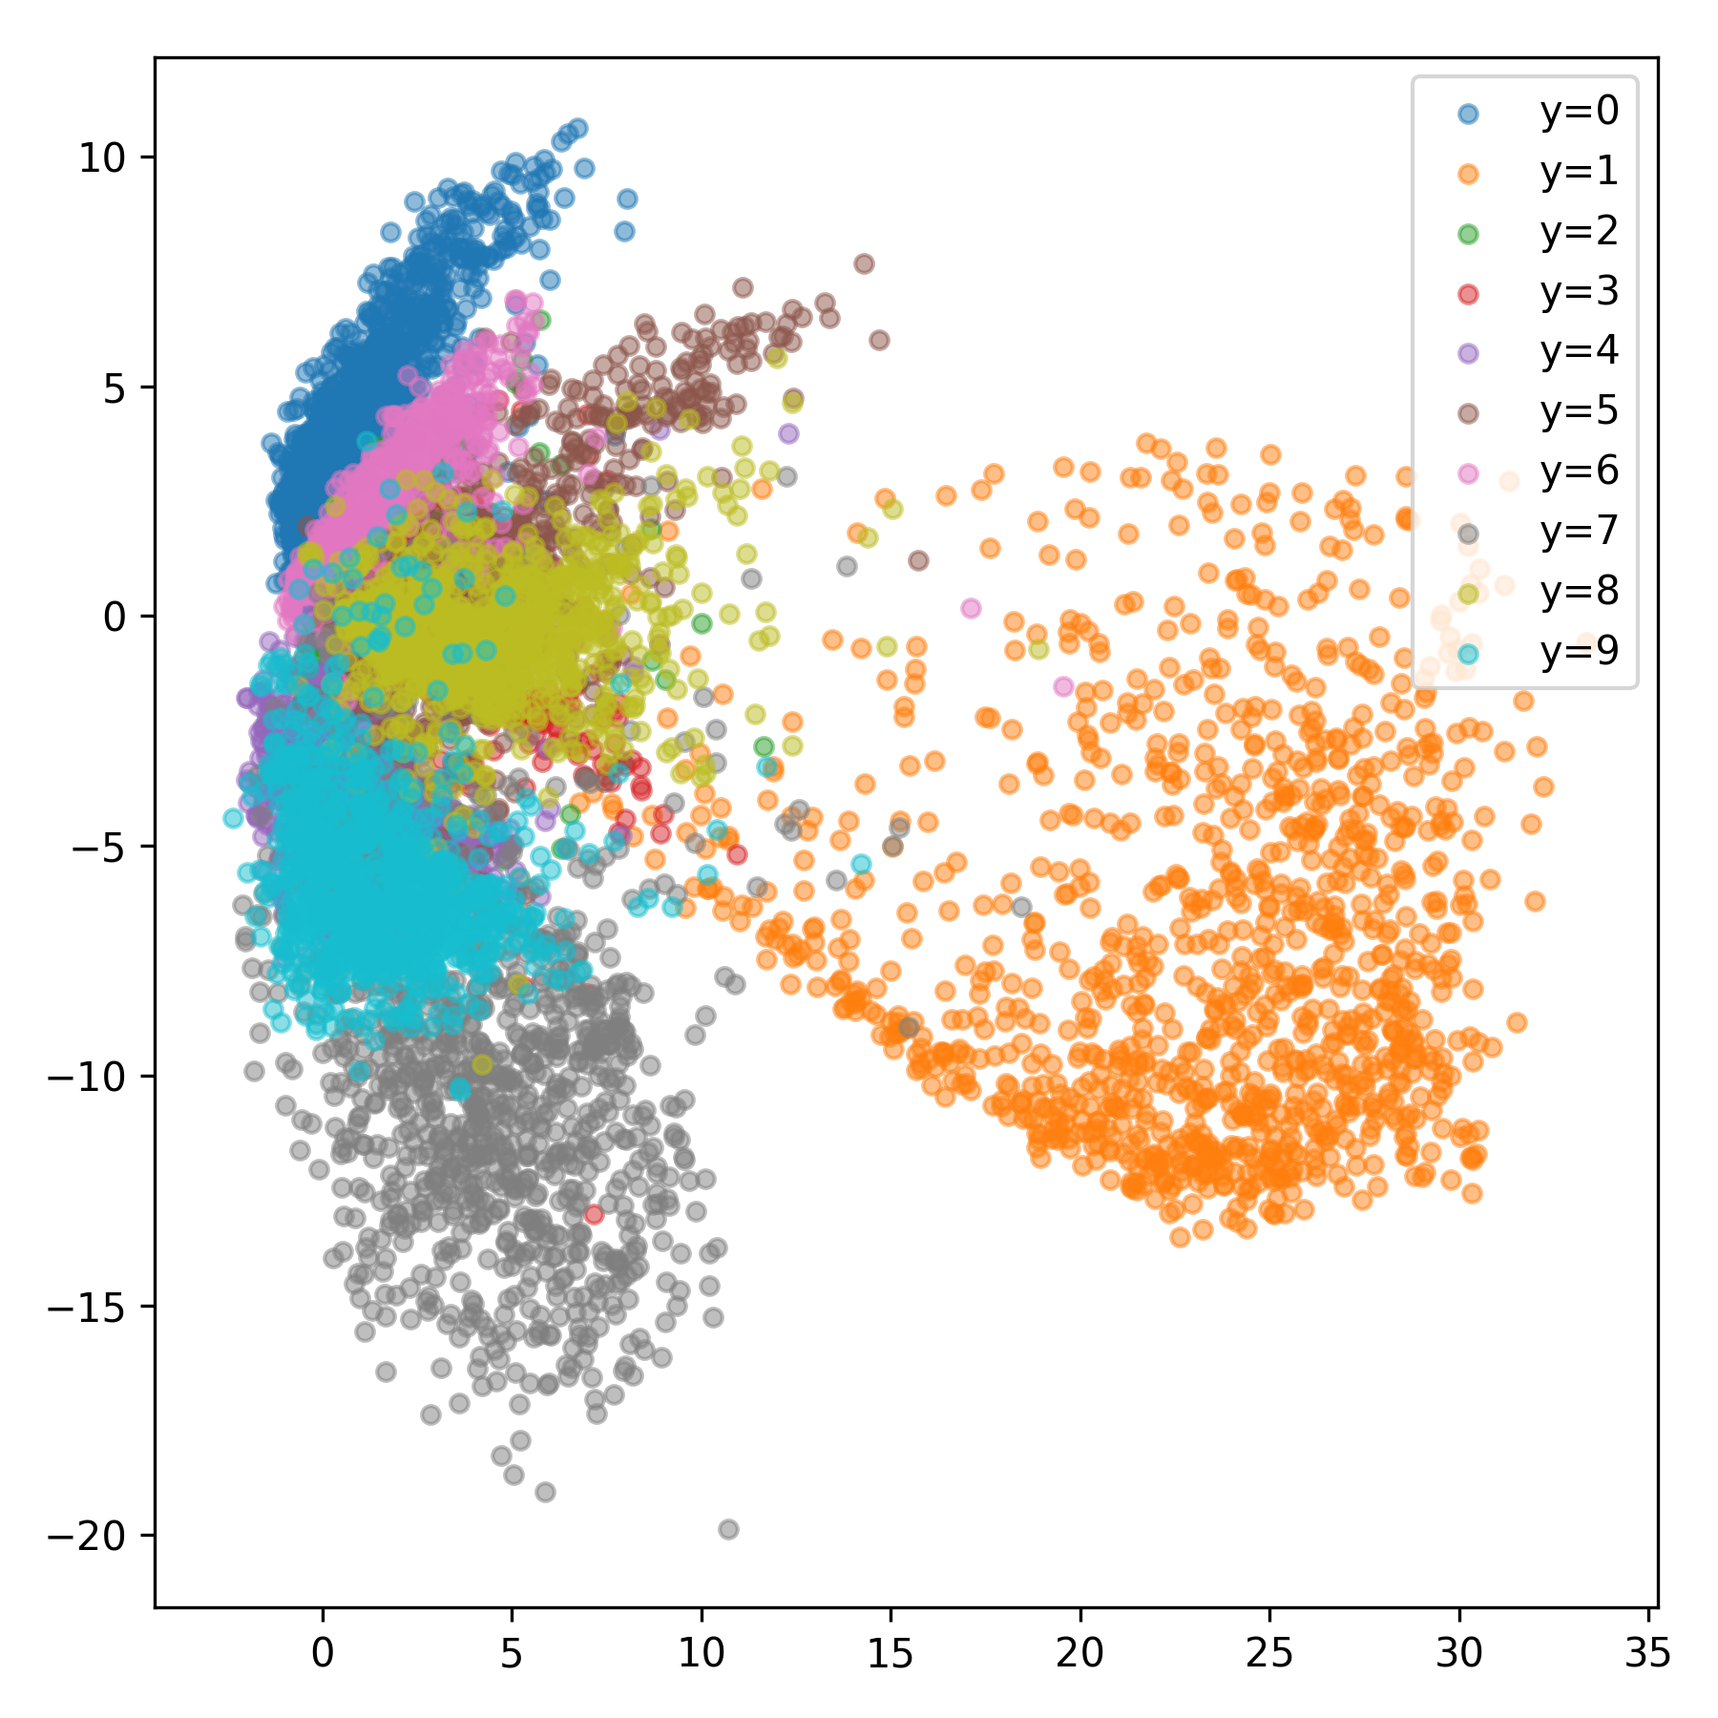
Autoencoders
Input
Images
Hidden
Units
Code
Learned Representation
Entangled Representation: Individual dimensions in code
encode some unknown combination of features in the data.

Slide 5
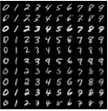
Disentangled Representations
Digit
(Have supervision)
Input
Images
Hidden
Units
Factorized
Code
Style
Goal: Learn features that correspond to distinct factors of variation
One Notion of Utility: Statistical independence

Slide 6
Learning Representations
Input
Images
Hidden
Units
Code
Hidden
Units
Reconstructed
Images

Slide 7
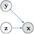
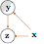
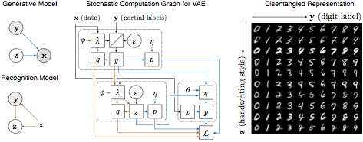
Semi-supervised Learning
Generative Model (Decoder)
Inference Model (Encoder)
Disentangled Representation
Assume independence between digit y and style z
Infer y from pixels x, and z from y and x
Separate interpretable y from “nuisance” variables z
Hypothesis: Assuming a statistical independence under the prior induces disentangled representations.
[Kingma, Mohamed, Jimenez-Rezende, Welling, Semi-supervised Learning with Deep Generative Models, NIPS 2014]

Slide 8
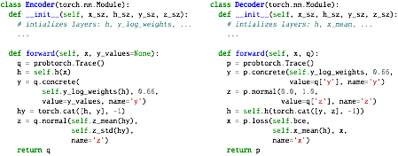
Deep Probabilistic Programs
Inference Model (Encoder)
Generative Model (Decoder)
Edward
Probabilistic Torch
Pyro
https://github.com/bleilab/edward
https://github.com/probtorch/probtorch
https://github.com/uber/pyro

Slide 9
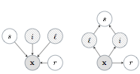
Example: Yale B Faces
Generative Model
Inference Model
Semi-supervised: Identity (i), Lighting (l)
Unsupervised:
Shading (s), Reflectance (r)
Data: Pixels (x)
Original
Reconstruction
Same Lighting, Different Identity
Same Identity, Different Lighting
[Siddharth, Paige, van de Meent, Desmaison, Wood, Goodman, Kohli, Torr, NIPS 2017]

Slide 10
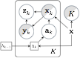
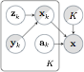
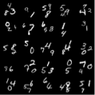
Example: Multiple MNIST Digits
Inference Model
Generative Model
Semi-supervised
Data
Unsupervised
Multiple MNIST digits
[Siddharth, Paige, van de Meent, Desmaison, Wood, Goodman, Kohli, Torr, NIPS 2017]

Slide 11
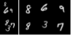
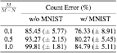
Example: Multiple MNIST Digits
Encoder
Decoder
Semi-supervised
Data
Unsupervised
Data
Decomposition
Accuracy
[Siddharth, Paige, van de Meent, Desmaison, Wood, Goodman, Kohli, Torr, NIPS 2017]

Slide 12
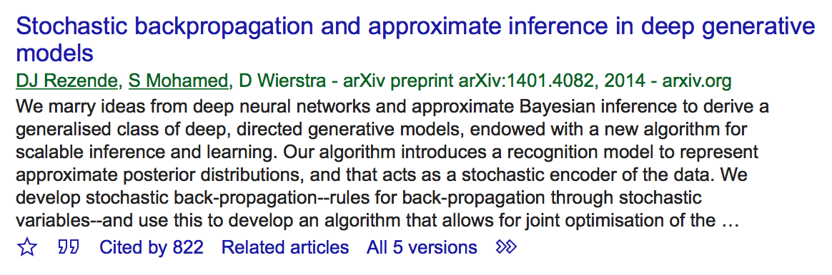
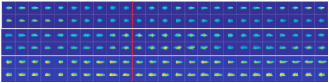
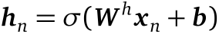
Deep Probabilistic Models
Example: Modeling Laboratory Mice with Deep State Space Models
[Johnson, Duvenaud, Wiltschko, Adams, Datta, NIPS 2016]
Data Science ❤️ Probabilistic Modeling + Deep Learning?
Structured priors model problem domain
Bayesian inference for uncertainty estimates
Neural likelihood models for data such as text and images
Neural inference models predict values for latent variables

Slide 13
Today: Unsupervised Learning
Generative Model (Decoder)
Inference Model (Encoder)
Disentangled Representation
Assume independence between digit y and style z
Infer y from pixels x, and z from y and x
Separate interpretable y from “nuisance” variables z
Hypothesis: Assuming a statistical independence under the prior induces disentangled representations.
Problem: Unsupervised learning (with same model) does not disentangle digit from style

Slide 14
Variational Autoencoders
(a.k.a. Deep Latent-Variable Models)

Slide 15
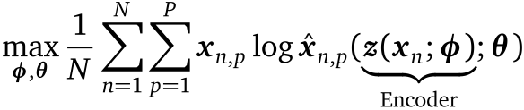
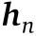
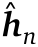
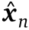
Autoencoders
Input
Images
Hidden
Units
Code
Hidden
Units
Reconstructed
Images
784
(28 x 28)
256
2-50
256
784
(28 x 28)

Slide 16
Autoencoders
Input
Images
Hidden
Units
Code
Hidden
Units
Reconstructed
Images
Encoder
Decoder

Slide 17
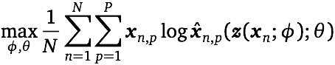
Autoencoders
Input
Images
Hidden
Units
Code
Hidden
Units
Reconstructed
Images
Objective: Maximize Reconstruction Quality

Slide 18
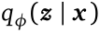
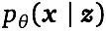
Variational Autoencoders
Input
Images
Hidden
Units
Mean
Std
Code
(Random)
Hidden
Units
Likelihood
Mean
Encoder (Inference Network)
Prior
Decoder (Likelihood)

Slide 19
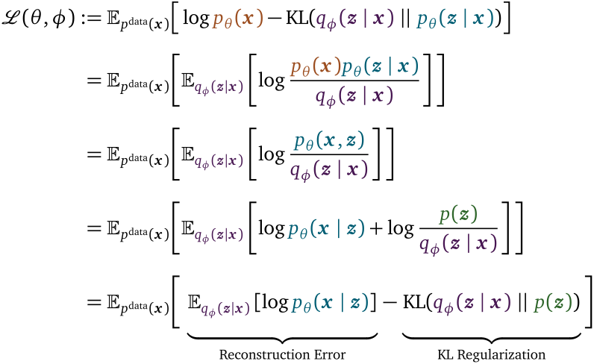
Variational Inference
Objective: Maximize Evidence Lower Bound
(computable)

Slide 20
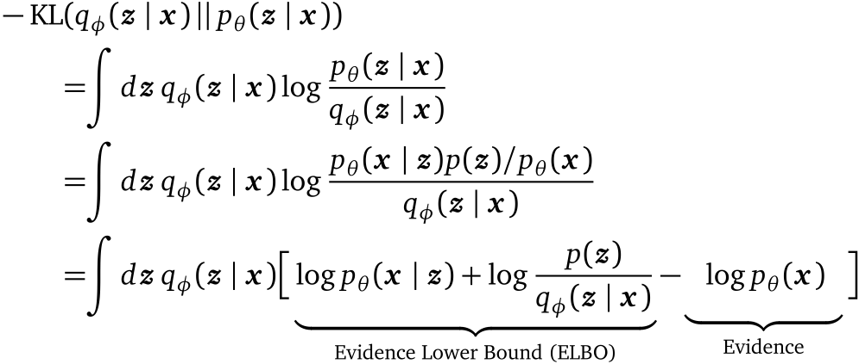
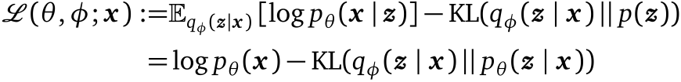
Variational Inference (in one Slide)
(by definition)
(Bayes rule)

Slide 21
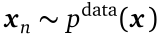
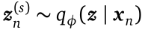
Variational Autoencoders
Input
Images
Hidden
Units
Mean
Std
Code
(Random)
Hidden
Units
Likelihood
Mean
Objective in Practice: Monte Carlo Approximation of Variational Lower Bound

Slide 22
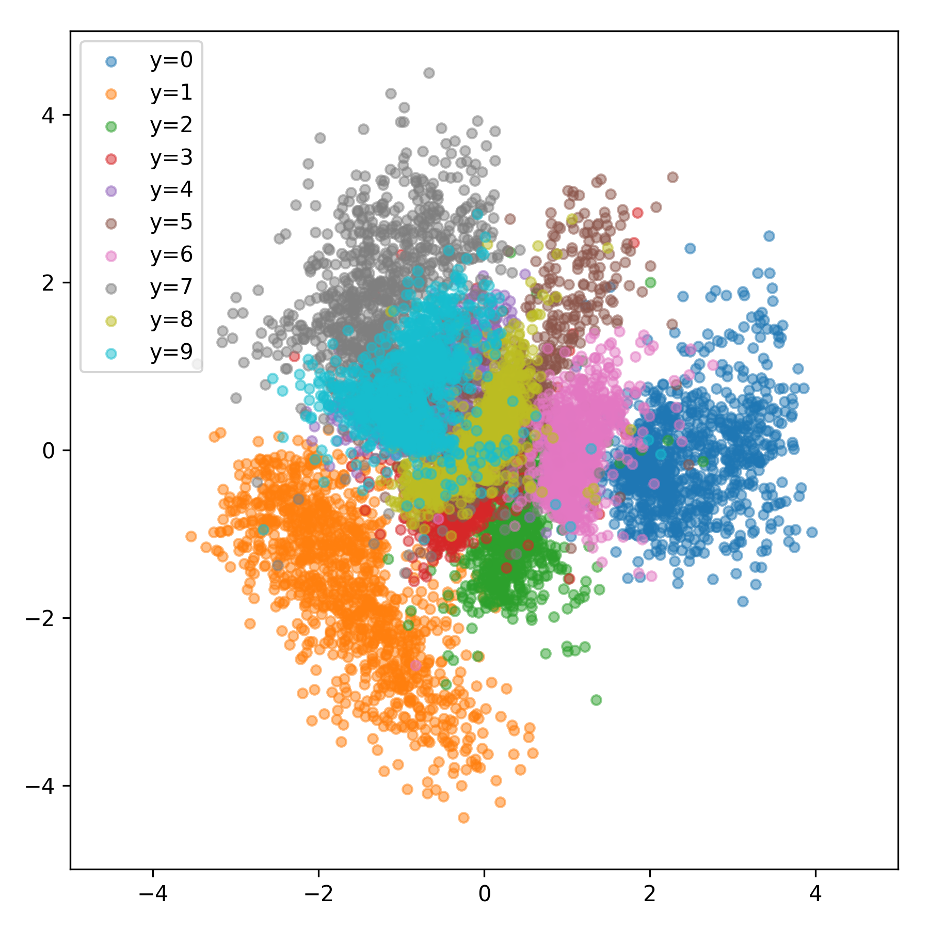
Regular vs Variational Autoencoders
Autoencoder (2-dim)
VAE (2-dim)
Arbitrary scale (no “typical” values)
Well-defined scale (-4 < z < 4)
KL regularization constrains values of latent codes

Slide 23
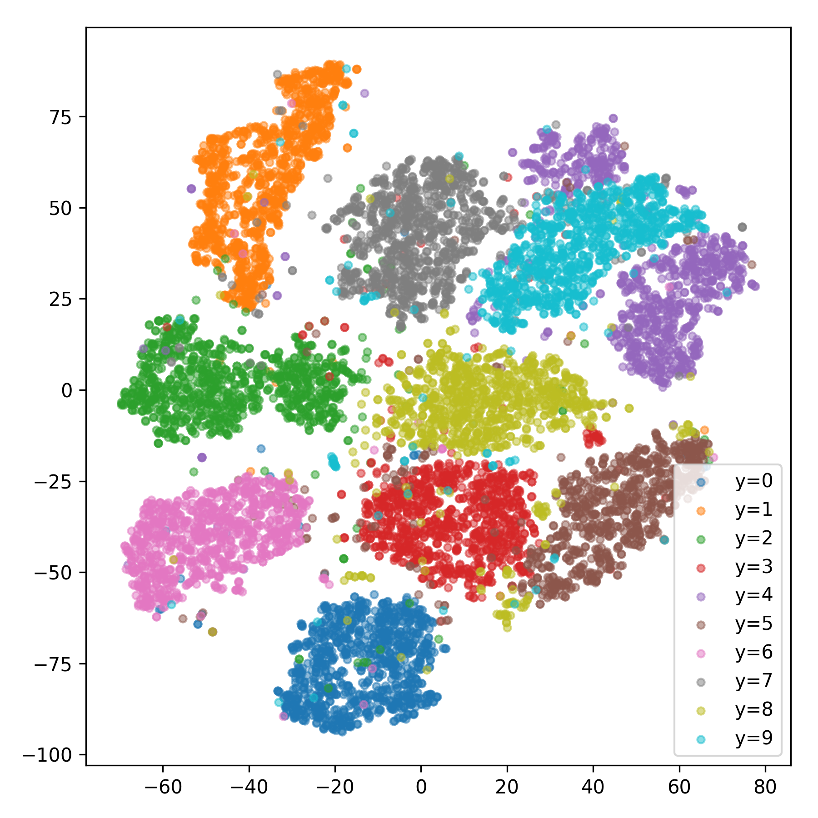
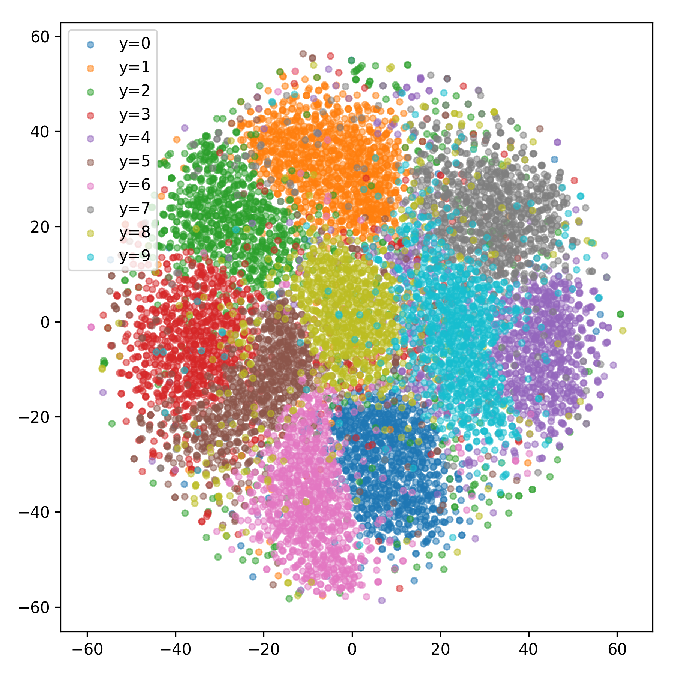
Regular vs Variational Autoencoders
Autoencoder (50-dim TSNE)
VAE (50-dim TSNE)
Representations are still entangled

Slide 24
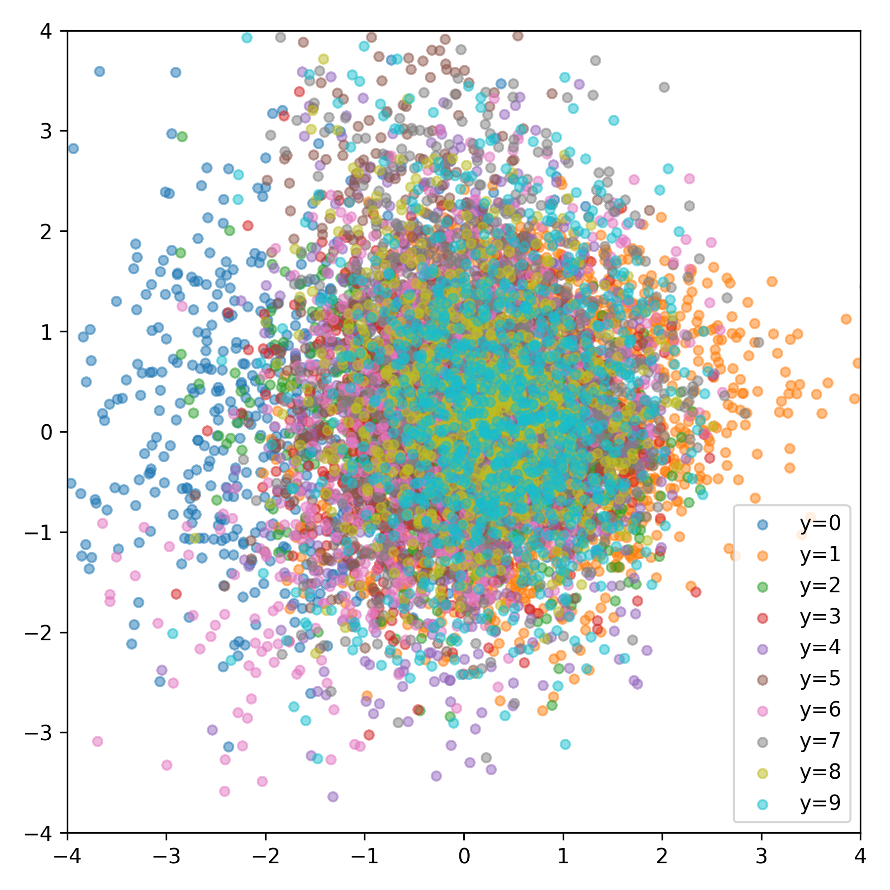
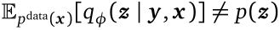
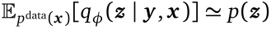
Unsupervised vs Semi-Supervised
Unsupervised, Entangled
Semi-supervised, Disentangled
Latent code z represents both style and digit
Style variable z is conditionally
independent from digit y (*)
(*but not without supervision)

Slide 25
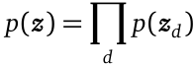
Unsupervised vs Semi-Supervised
Unsupervised, Entangled
Semi-supervised, Disentangled
In both models, prior on z assumes uncorrelated dimensions

Slide 26
MNIST with (some) Supervision
Disentangled Representation
Probabilistic Encoder
Probabilistic Decoder
Separate interpretable y from “nuisance” variables z
Predict y from pixels x, then predict z from y and x
Predict pixels x from y and z

Slide 27
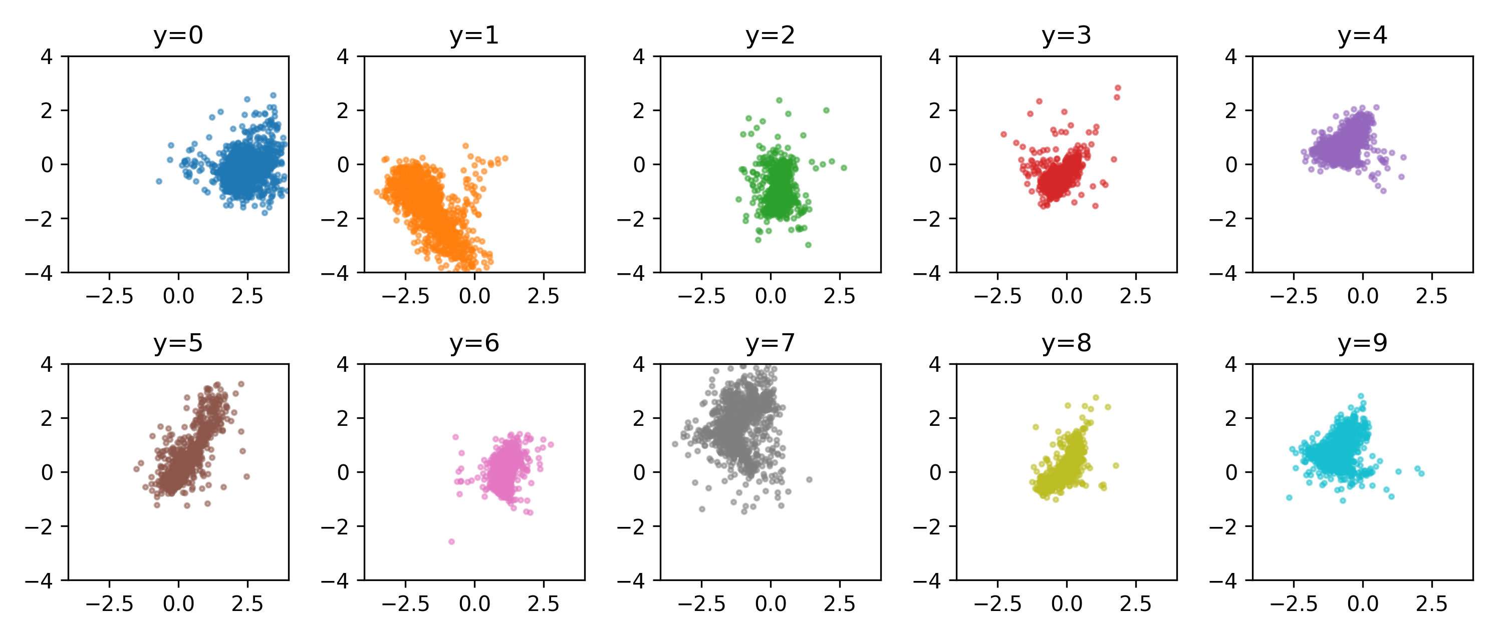
Conditional Distributions
Unsupervised

Slide 28
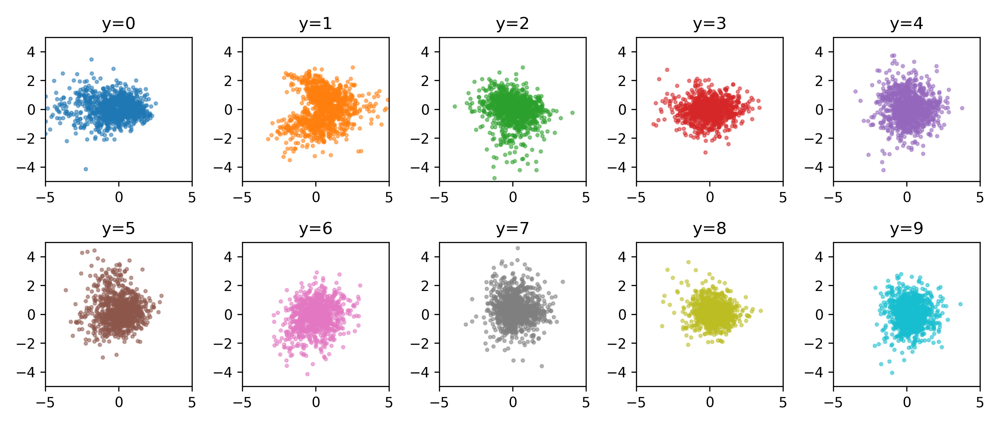
Learned Embeddings (2-dim)
Semi-Supervised

Slide 29
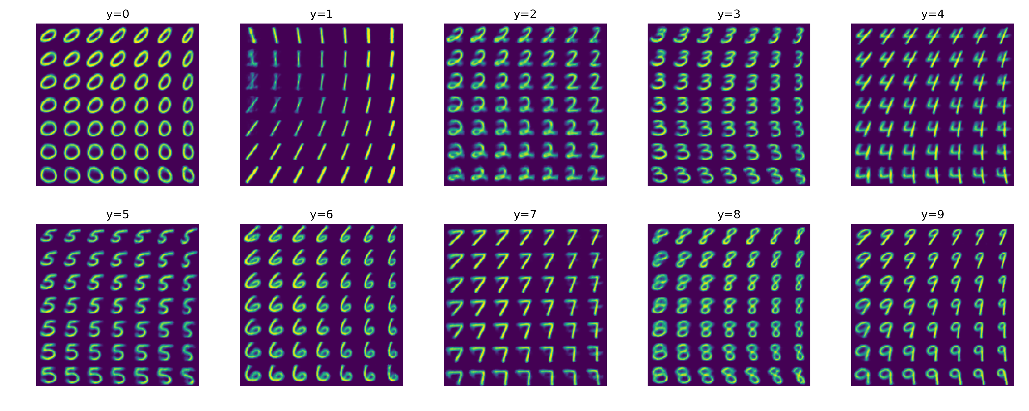
Reconstructions (2-dim)

Slide 30
Learning Statistically
Independent Factors

Slide 31
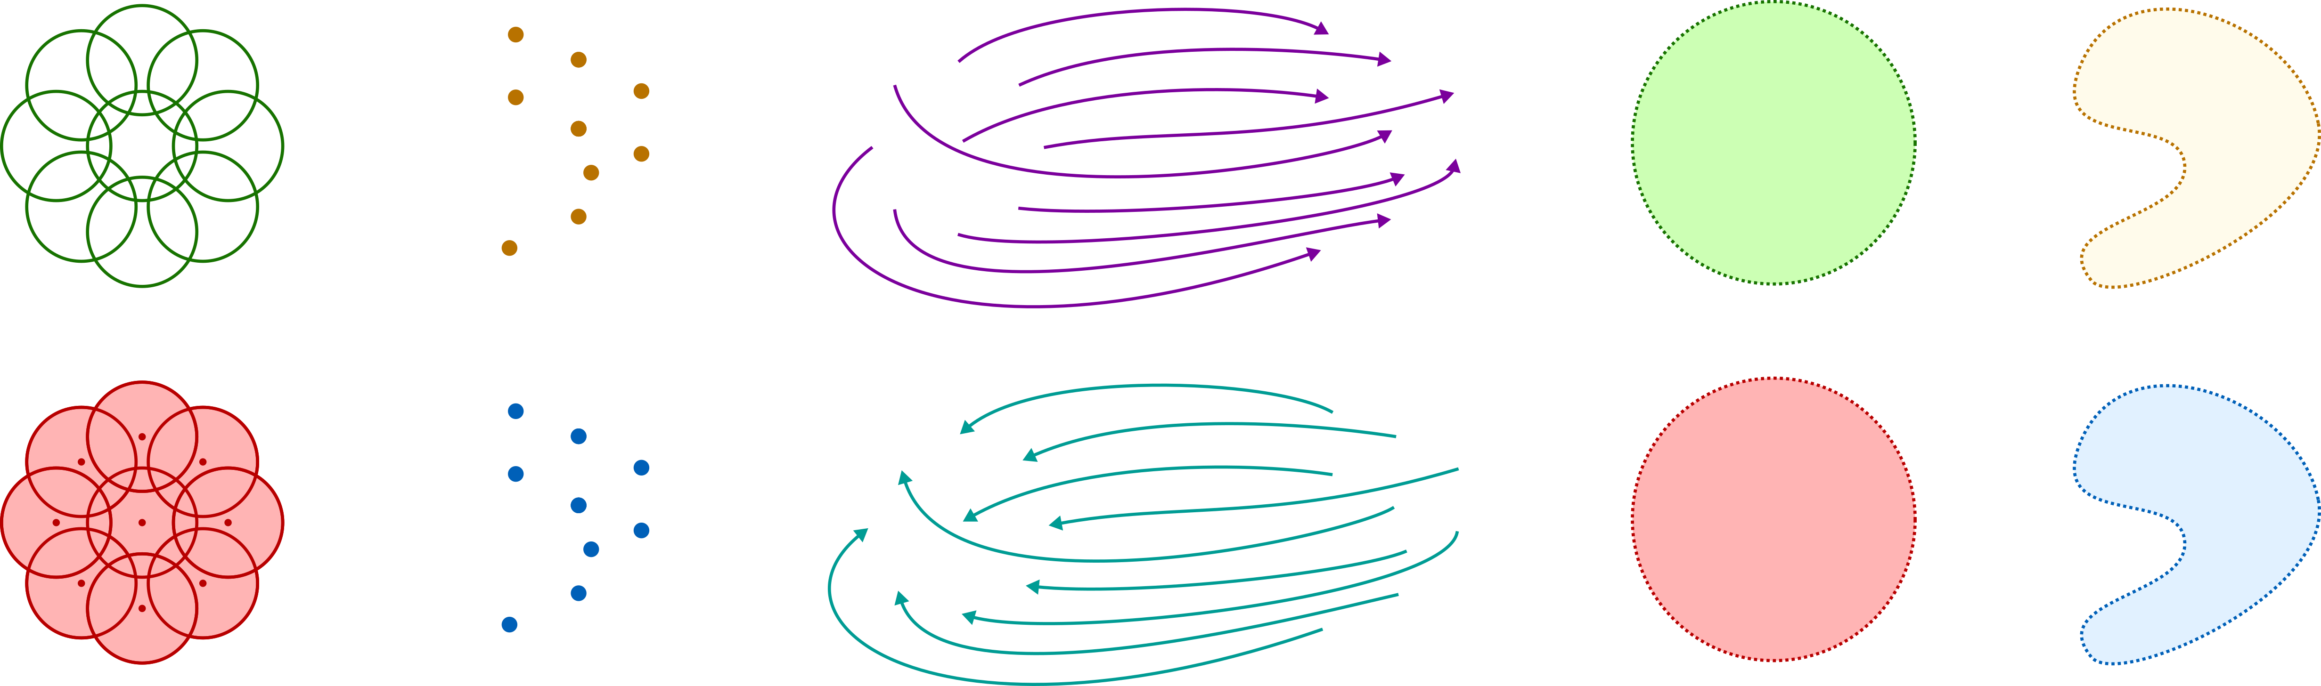
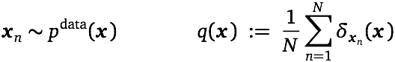
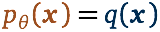
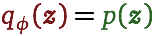
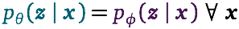
Deep Latent-Variable Models
Generative Model
Inference Model
Prior
(known)
Data Distribution
(learned)
Inference Marginal
(learned)
Empirical Distribution
(known)
Constraints: Models are Equivalent when
Data Sampled from Unknown Distribution
Approximation of
Data Distribution

Slide 32
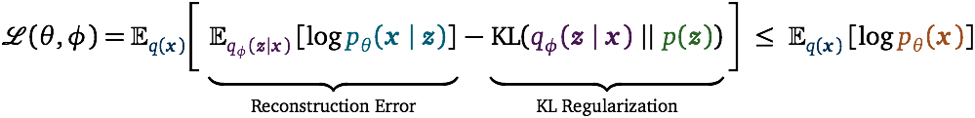
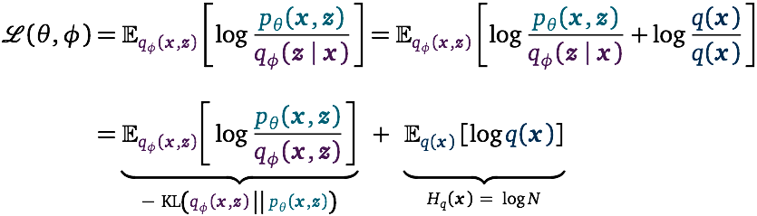
Implicit Tradeoffs in the Variational Objective
Classical View: Maximize Evidence Lower Bound
Alternate View: KL Divergence Between Two Models

Slide 33
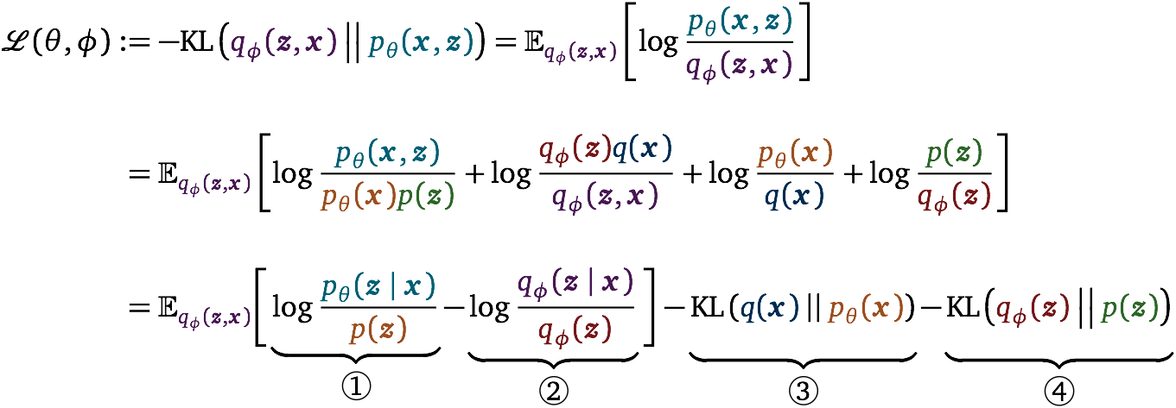
Implicit Tradeoffs in the Variational Objective
[Hoffman, Johnson, NIPS AABI Workshop 2016], [Chen, Li, Grosse, Duvenaud, Arxiv 2018]
[Esmaeli, Wu, Jain, Bozkurt, Siddharth, Paige, Brooks, Dy, van de Meent, Arxiv 2018]

Slide 34
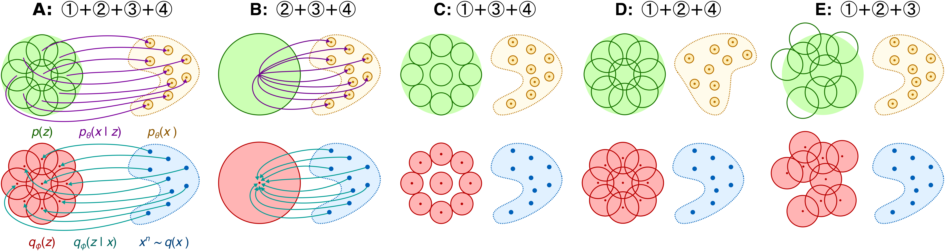
Relaxing Constraints in the Objective
② + ③ + ④
① + ③ + ④
① + ② + ④
① + ② + ③
Idea: Relax ①, ②, and ③ in favor of ④
[Esmaeli, Wu, Jain, Bozkurt, Siddharth, Paige, Brooks, Dy, van de Meent, Arxiv 2018]

Slide 35
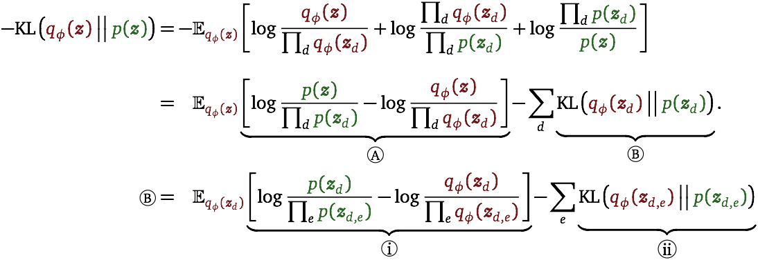
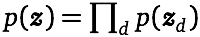

Hierarchical Decomposition
Correlations between variables
should be identical
Marginals should
be identical
Disentanglement:
(Can continue decomposition for any number of levels)
[Esmaeli, Wu, Jain, Bozkurt, Siddharth, Paige, Brooks, Dy, van de Meent, Arxiv 2018]

Slide 36
Hierarchical Decomposition
Correlations between variables
should be identical
Marginals should
be identical
Disentanglement:
(Can continue decomposition for any number of levels)
[Esmaeli, Wu, Jain, Bozkurt, Siddharth, Paige, Brooks, Dy, van de Meent, Arxiv 2018]

Slide 37

Generalizations of VAE objectives
Hierarchically Factorized Variational Autoencoders

Slide 38

Results: CelebA
HFVAE and β-VAE are qualitatively similar
Both objectives learn (some) interpretable features

Slide 39


Results: MNIST and FMNIST

Slide 40

Results: Generalization

Slide 41

Bonus: Learning Correlations Between Topics
VAE (50 topics)
HFVAE (25 + 25 topics)
Top Words
jesus, scripture, god, christ, bible, sin, christian, doctrine, faith, church
team, game, player, score, league, play, leafs, hockey, season, nhl
scsi, ide, controller, drive, bus, subject, lines, organization, card, problem
NPMI
0.41
0.37
0.14
Top 3 Most Correlated Topics
armenian, turk, civilian, turkish, soldier, kill, extermination, armenia, israel, jew
jesus, belief, god, christian, christ, faith, scripture, moral, truth, sin
gun, crime, people, law, defense, government, criminal, shoot, assault, fire
NPMI
0.40
0.35
0.26

Slide 42
Deep Learning + Probabilistic Programming
Deep
Learning
Integrated
Approaches
Probabilistic Programming
Discriminative
(Data ⇾ Features)
Autoencoders
Generative
(Variables ⇾ Data)
Large Data,
Low Uncertainty
Decision Making
Small Data,
High Uncertainty
Stochastic Gradient Descent
Variational Inference
Many Inference
Methods
Representation
Learning
Model-based Reasoning

Slide 43
Thank You!
Northeastern University
Oxford
ATI
Babak Esmaeli
Hao Wu
Sarthak Jain
Alican Bozkurt
Siddharth N.
Brooks Paige
Papers
Structured Disentangled Representations B. Esmaeili, H. Wu, S. Jain, A. Bozkurt, N. Siddharth, B. Paige, D. H. Brooks, J. Dy, J.-W. van de Meent ArXiv [https://arxiv.org/abs/1804.02086]
Learning disentangled representations with semi-supervised deep generative models N. Siddharth, B. Paige, J.-W. van de Meent, A. Desmaison, F. Wood, N.D. Goodman, P. Kohli, P.H.S. Torr NIPS 2017 [https://bit.ly/probtorch-nips-2017]
Code
https://github.com/probtorch/probtorch

